Slide 1

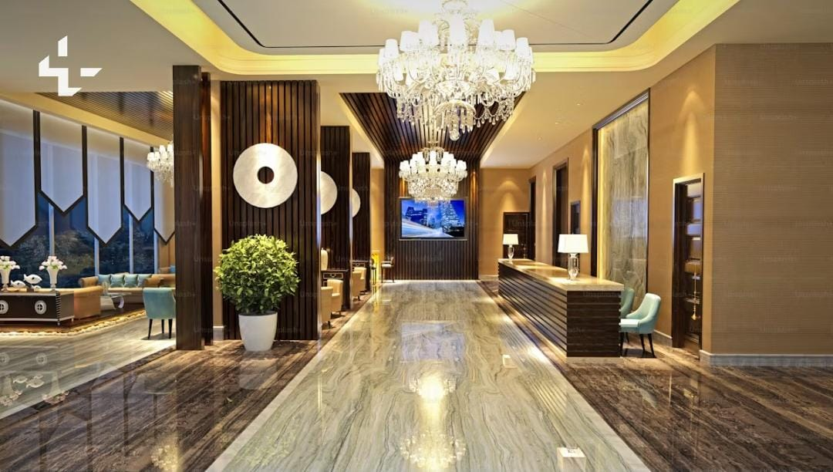
HOTEL BOOKING ANALYSIS
Presented By:
Rupali Gandole
Guided By:
Abhishek Wavhal

Slide 2
TABLE OF
CONTENTS
Project Summary
01
Problem Statement
05
Problem Statement
Data Cleaning
02
06
Expected Outcomes
Data Visualization and Analysis
03
07
About Data
Conclusion
04
08

Slide 3
PROJECT SUMMARY
To evaluate City Hotel and Resort Hotel's business performance from 2015 to 2017 to conduct an in-depth study of them.
This Analysis data includes booking ID's, ADR , cancellations, lead time and guest details.
- This process involve cleaning, wrangling and visualizing the data set to identify business insights and improve operations.

Slide 4
PROBLEM
STATEMENT
The dataset contains of booking information for city hotel and resort hotel, including the booking date, number of adults, children and babies, available parking spaces, booking agent, and other relevant information. This project examines and analyzes the data to determine important factors affecting bookings.
The main objective is to identify factors that impact hotel booking and ADR to improve business outcomes and guest experience.

Slide 5
EXPECTED
OUTCOMES
- Improved Decision-Making
- Decreased Cancellations
- Enhanced Profit Margins
- Long-Term Strategy
- Stay Competitive

Slide 6
ABOUT
DATA
Booking Information:
Hotel Type: Resort Hotel or City Hotel
Cancellation Status: Booked (0) or Cancelled (1)
Lead Time: Number of days between booking and arrival
Arrival Details: Year, Month, Week Number
Duration of Stay: Stay in weekend nights, Stay in weekdays nights
Guest Details:
Guest Breakdown: Adults, Children's and Babies
Country of Residence: Guest's native land
Repeated Guest: Yes (1) or No (0)
Meal Choice: Meal type reserved

Slide 7
ABOUT
DATA
Booking History:
Previous Cancellations: Number of past cancellations
Number of confirmed bookings: Number of past non-cancelled bookings
Room Information:
Type of Room Reserved: Code for the room type that was reserved
Type of Room Assigned: Code for the room type that was assigned
Changes to Booking: Total number of modifications made to the reservation.

Slide 8
ABOUT
DATA
Financials & Extras:
Average Daily Rate (ADR): Calculated price per day
Required Extras: Number of car parking spaces, specific requests
Booking Channels:
Market Segment: Classification based on booking trends
Distribution Channel: Method of distributing bookings
Agent: Unique identifier for booking agents
Reservation Status:
Current Reservation Status: Present booking status
Last Update of Reservation Status: Date of the most recent status change

Slide 9
DATA
CLEANING
There were a total of 1,19,390 rows and 32 columns.
Errors, Duplicate rows and Blank rows removed.
Merged columns day, month and year into a column called arrival_date
Merged columns stay_in_weekend_nights and stay_in _week_nights into a column called total_number_of_days.
Merged columns adults, children and babies into a column called total_guests.
Removed company and Days_in_waiting_list column because as most NULL values.
Added a calculated column called [Week of Day], which stores the day of the week in words rather than numbers.
Added index column called Booking_Id.

Slide 10
Data Visualization and Analysis

Slide 11
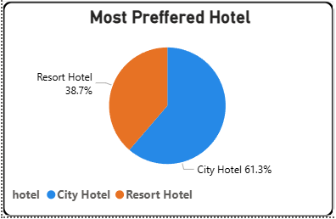
MOST PREFERRED
HOTEL TO STAY
Based on the Pie chart, we can say that 61.3% of people prefer the City Hotel and 38.7% of people prefer the Resort Hotel.
Based on these observations, we understand that city hotel provides services which attract more guests.
Resort hotels can enhance their offers to improve market share

Slide 12
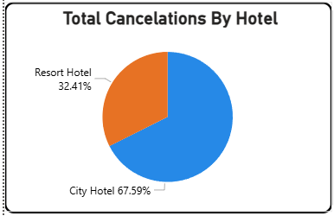
MOST CANCELATIONS
BY HOTEL
Based on the Pie chart, we can say that City Hotel has faced 67.59% cancellations and Resort Hotel has faced 32.41% % cancellations. Based on these observations, we say that though the city hotel has a higher number of bookings, it also has a higher number of cancellations.

Slide 13
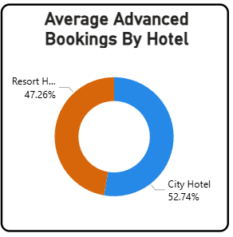
AVERAGE ADVANCED BOOKING
BY HOTEL
Based on the Donut chart, we can say that City Hotel has 52.74% advanced booking and Resort Hotel has 47.26% advanced booking,.
Based on these observations, we say that guests prefer to advance book city hotels as compared to resort hotels.

Slide 14
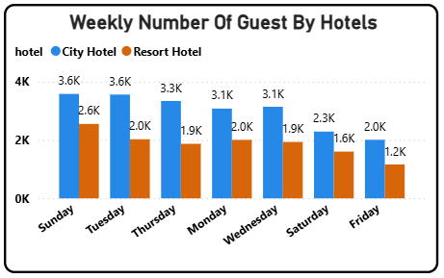
WEEKLY NUMBER OF GUESTS
BY HOTELS
The Clustered Column chart shows weekly data by hotels. Based on the column chart, we can say that most guests arrive on Sunday for both City Hotels and Resort Hotels.

Slide 15
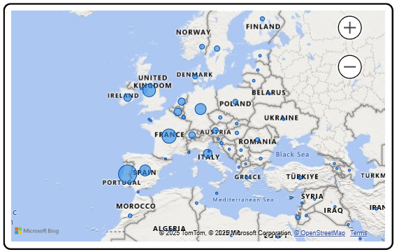
GUESTS FROM MOST VISITED COUNTRIES
The Map shows from which country the maximum number of guests visit.
Based on the map, we can say that most guests visit from Portugal, the UK and France.

Slide 16
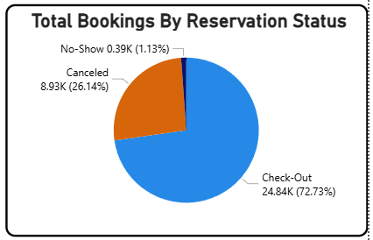
BOOKING STATUS
OF GUESTS
Based on the Pie chart, we can say out of all the bookings, 72.73% of guests Checked-Out, 26.14% of guests Cancelled the booking, while only a 1.13% of guests, were a No-Show.

Slide 17
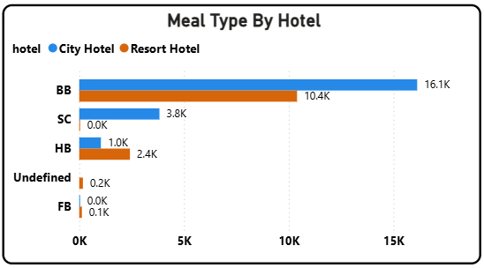
MEAL TYPES OF HOTELS
GUESTS
The Clustered Bar chart shows the meals type for guests of different hotels.
Based on the bar chart, we can say that most of the guests prefer BB meal type.

Slide 18
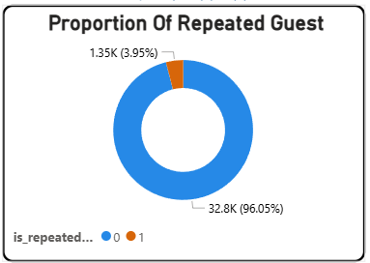
PROPORTION OF REPEATED
GUESTS
Based on the Donut chart, only 3.95% guest visits repeat.
Based on this observation, If hotels offers some discount coupons to guest it will help them to increase proportion of repeated guest.

Slide 19
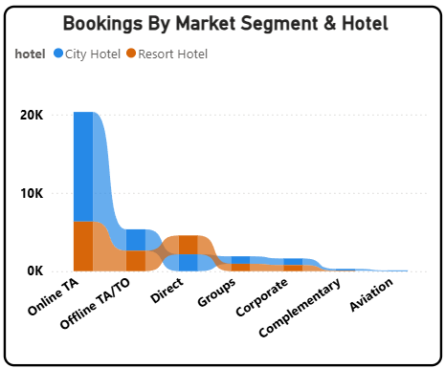
MOST PREFERRED
MARKET SEGMENT
The Ribbon chart shows the most preferred market segment for city hotels and resort hotels
Based on the ribbon chart, we can say that the most preferred market segment is Online TA, which is approximate. 17K for City Hotel and 6K for Resort Hotel, respectively.

Slide 20
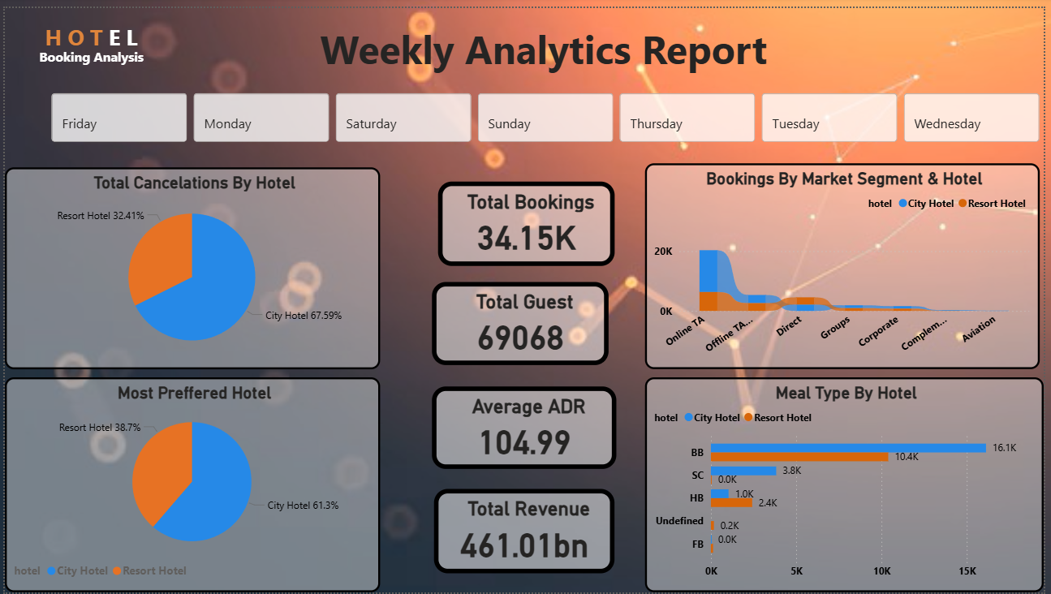

Slide 21
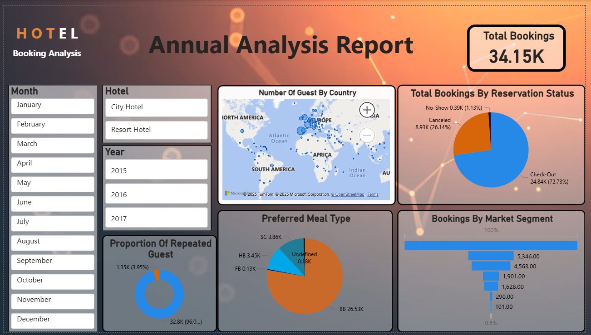

Slide 22
CONCLUSION
This Analysis shows City Hotels has higher booking rate than Resort Hotels.
City Hotels have more cancellations than Resort Hotels. They should try strategies to keep guests and reduce cancellations.
City Hotel can increase repeat guest by adding loyalty benefits and better customer experience.
Focusing on ‘BB’ as the preferred meal choice and customizing the dining options and experiences could improve guest contentment.
Most guests come from Portugal, the UK, and France. Keep Marketing in these countries can bring more bookings.
Only Few guests are coming back Loyalty program can help to increase repeat stay.
Many bookings come through agents. Hotels should build strong partnerships with them.
Overall, these insights will help hotels increase revenue, attract more customer and improve satisfaction.

Slide 23
THANKS!

